Slide 1



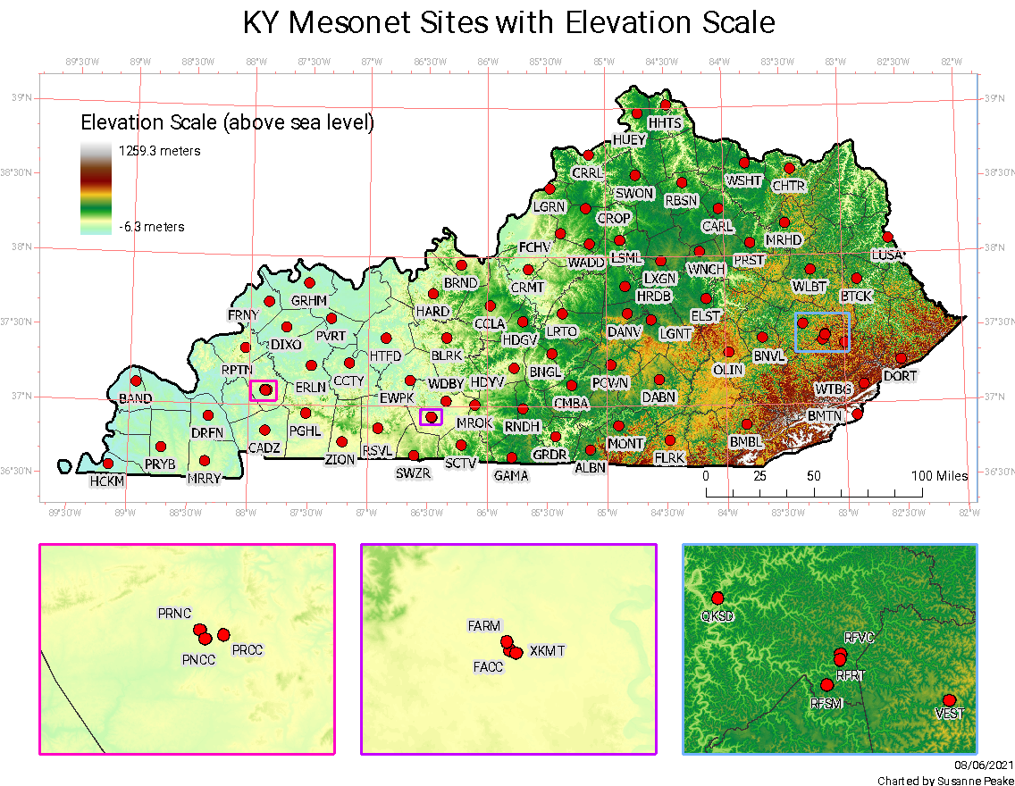
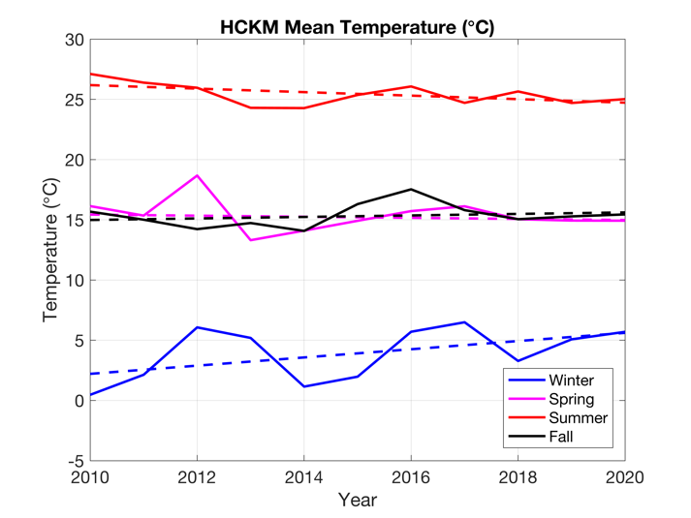
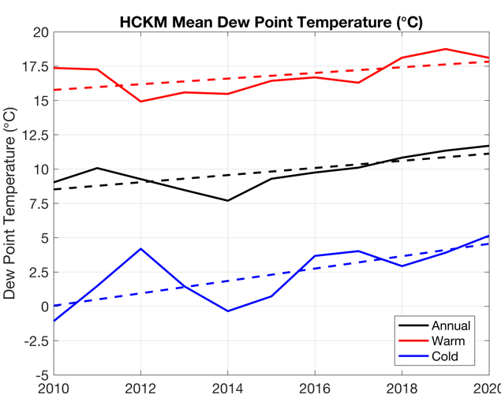
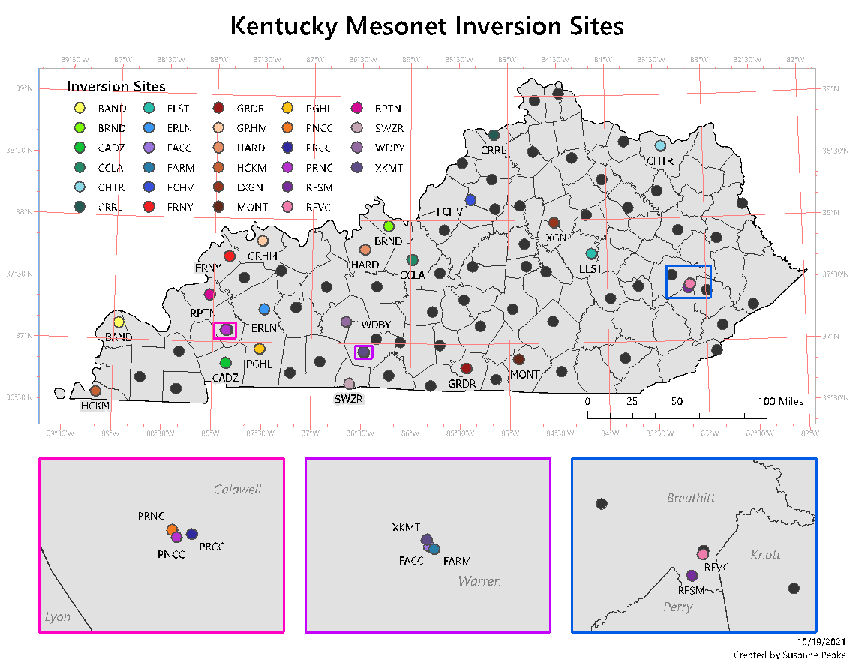
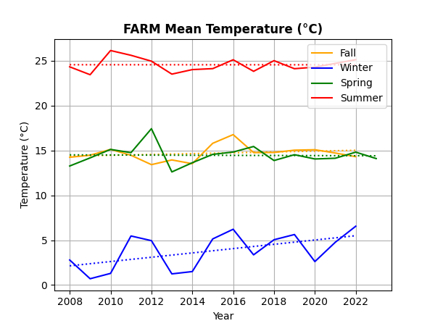
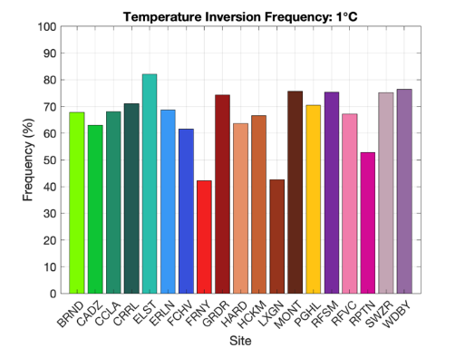
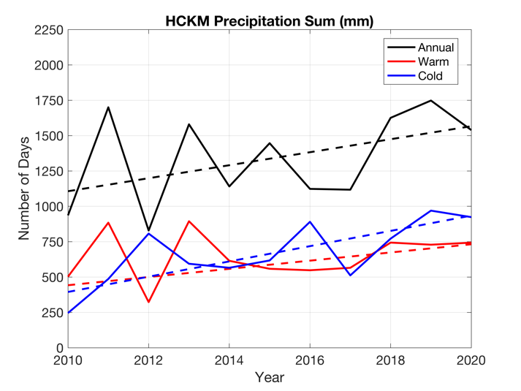
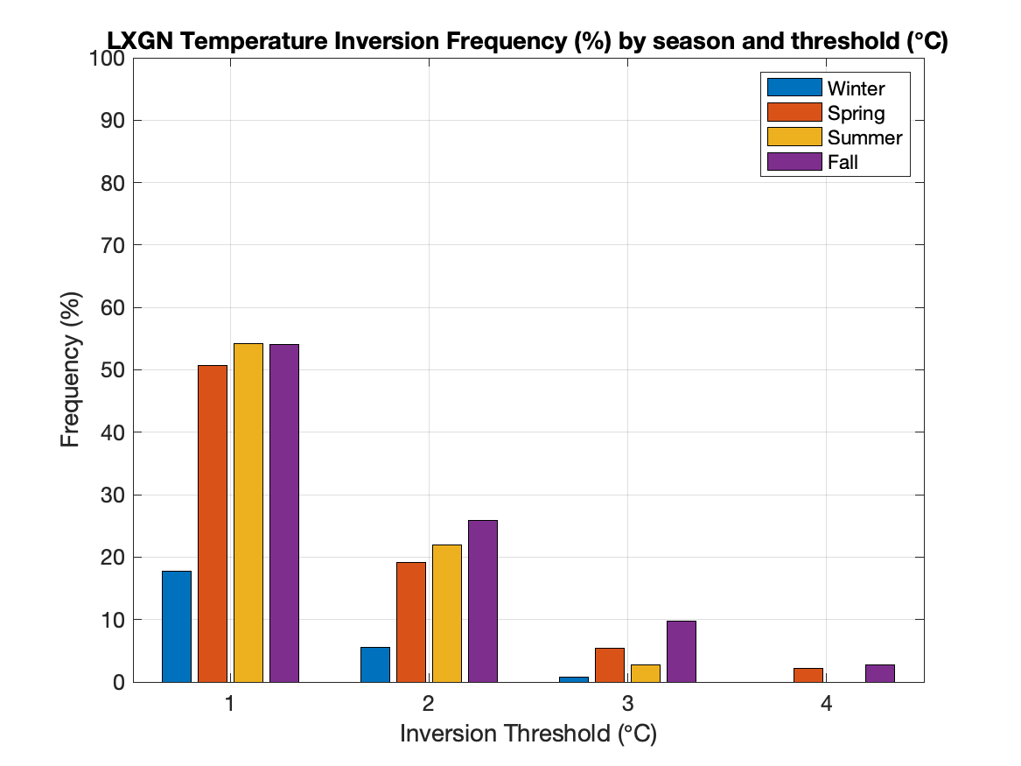
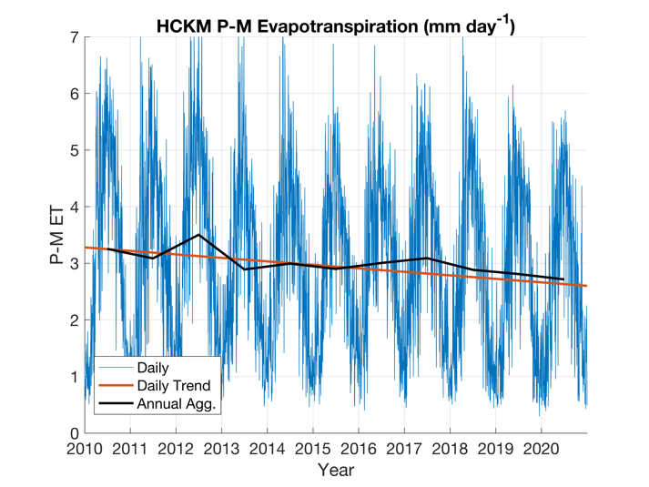
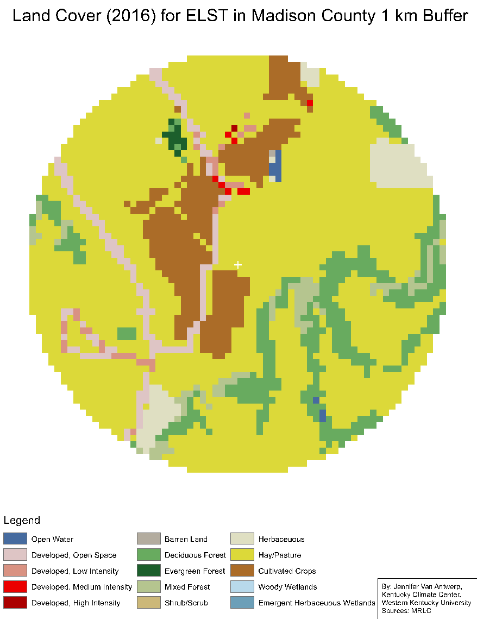
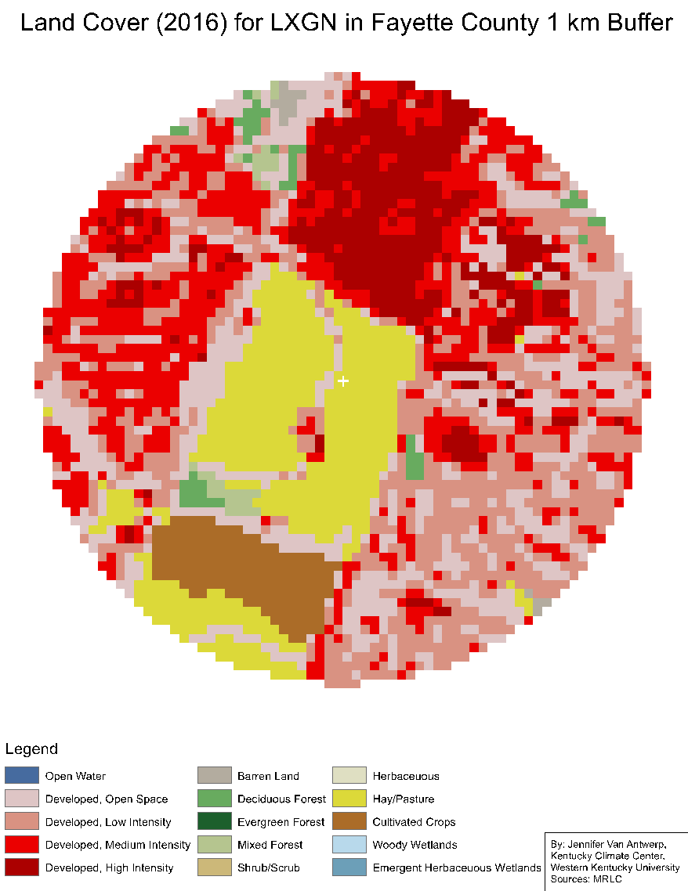
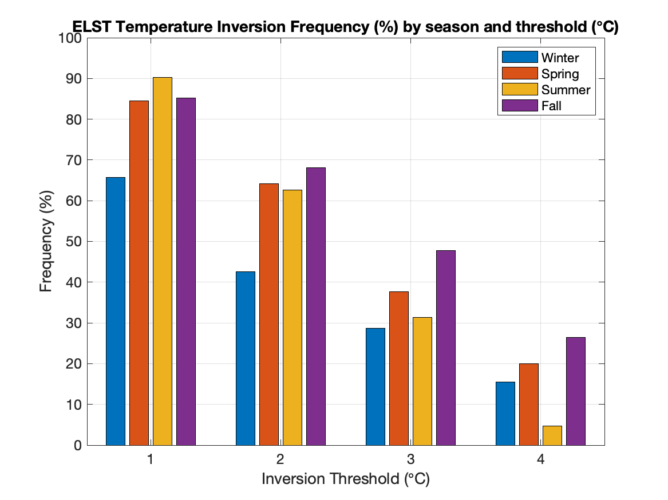
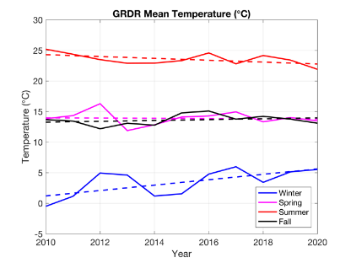
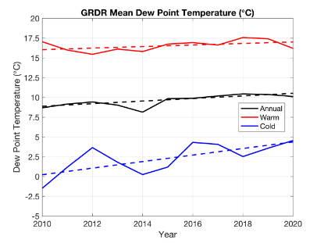
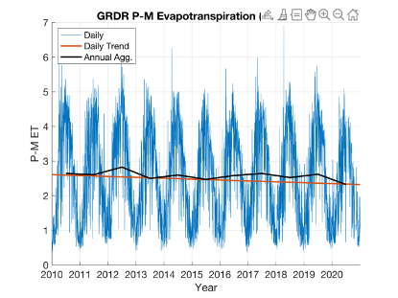
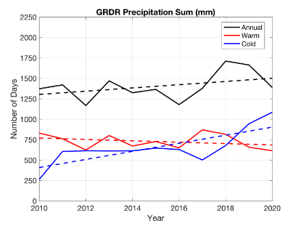
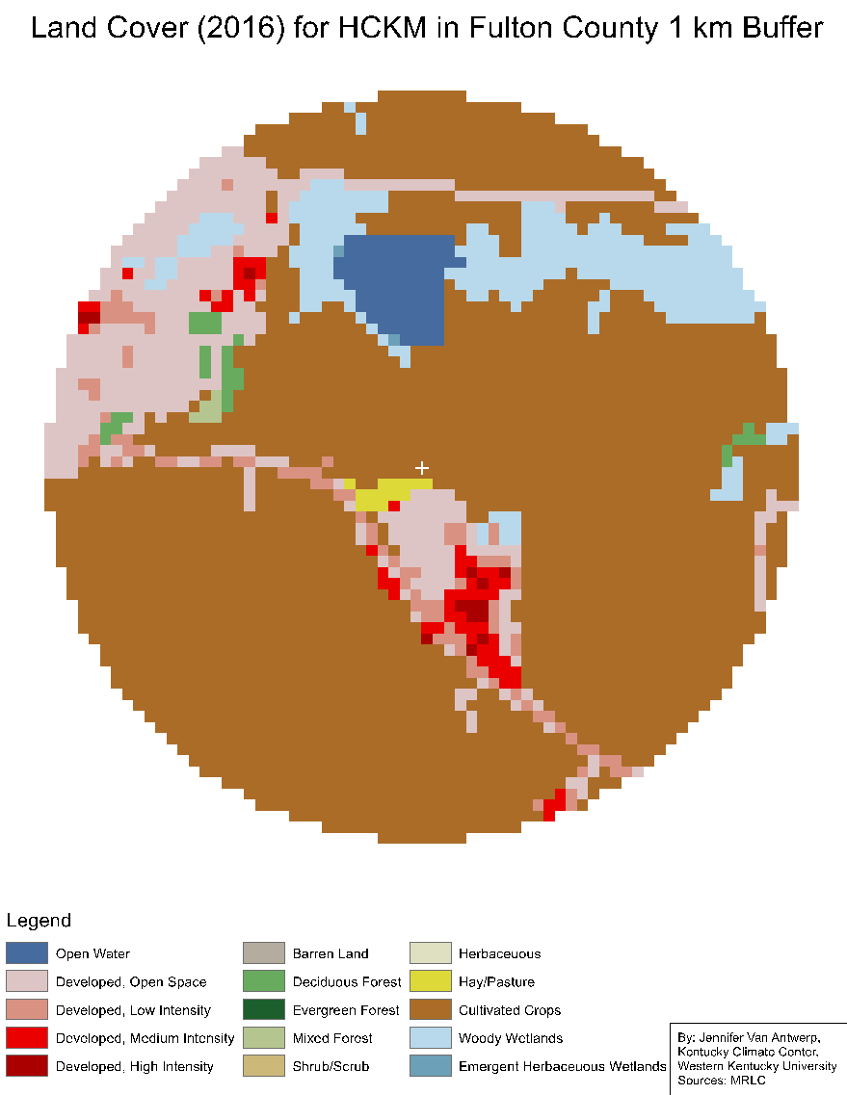
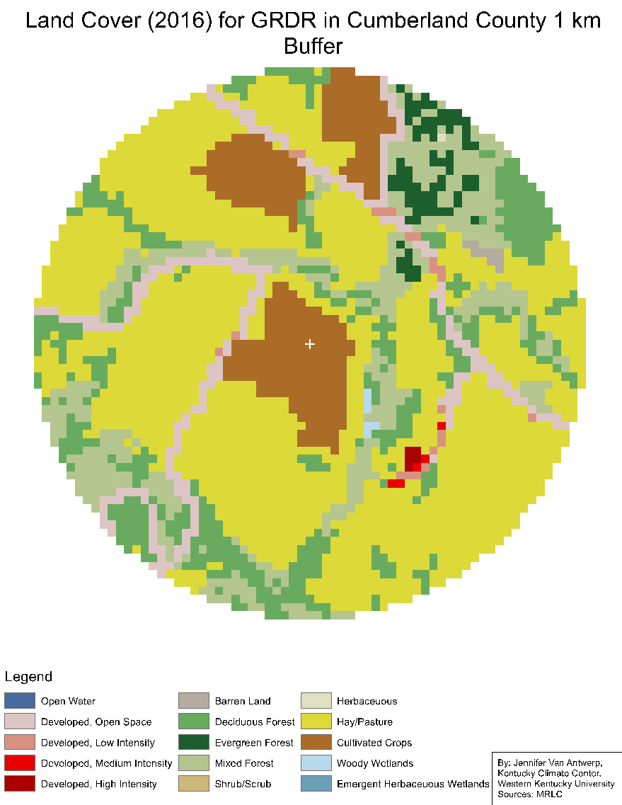
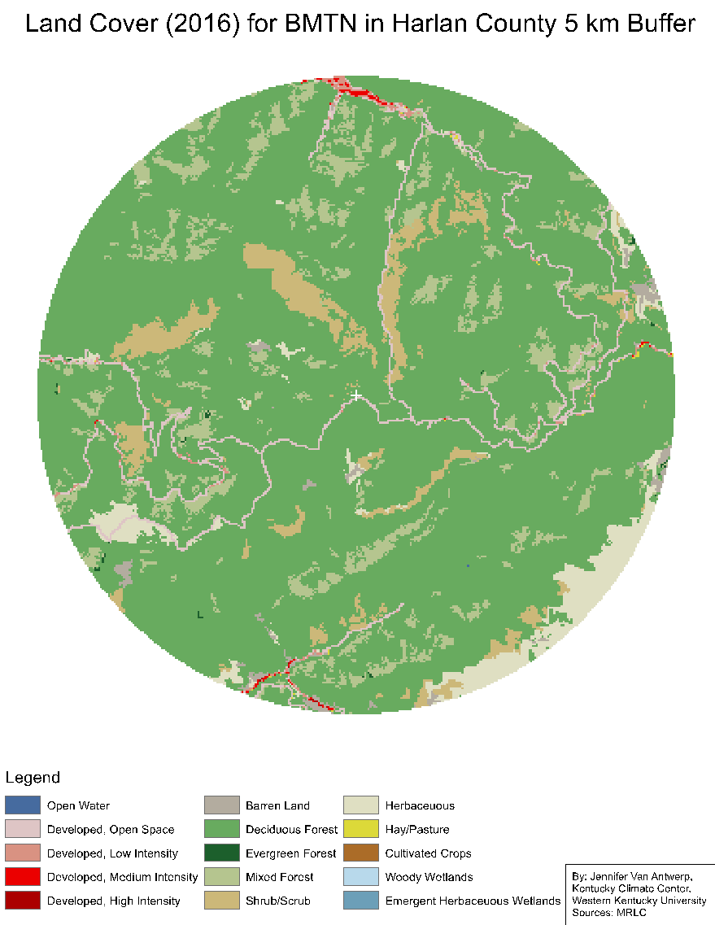
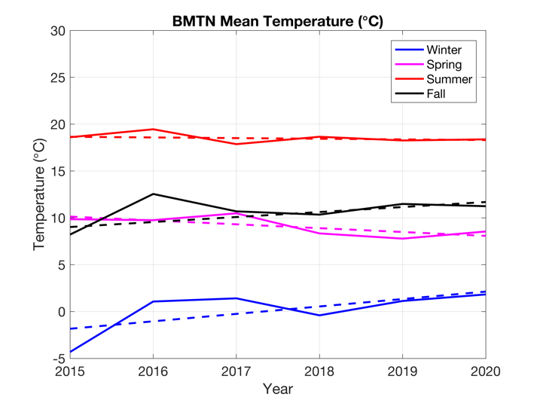
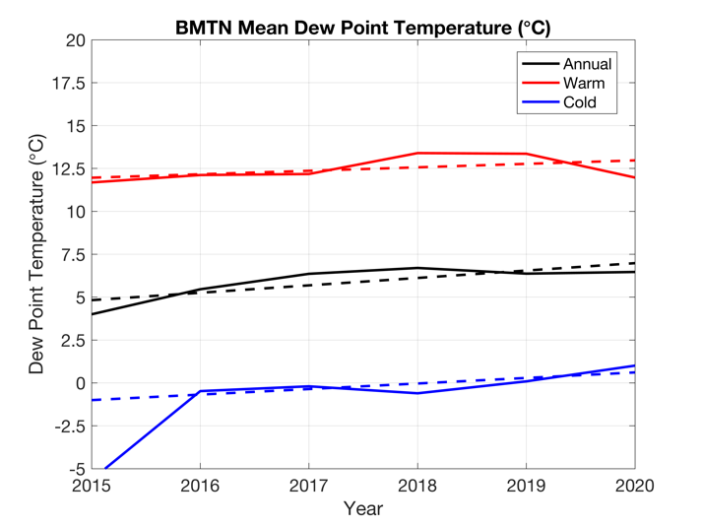
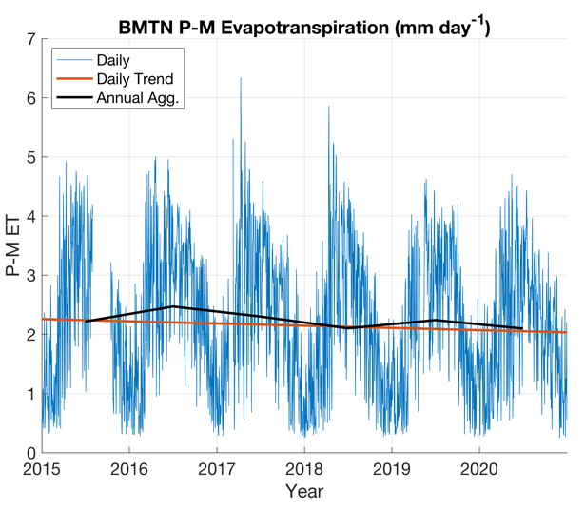
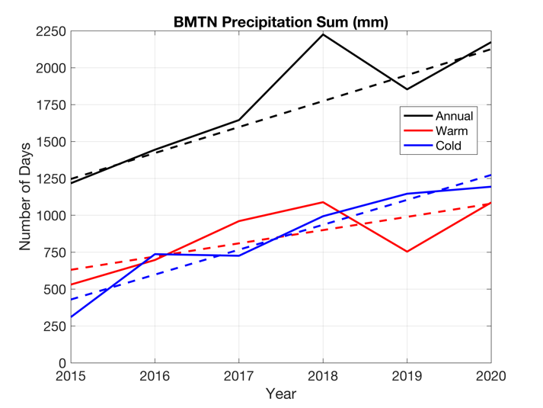
Climate and Temperature Inversion Statistics for Kentucky
Based on Mesonet Observations
By Brittany Pekara
Eric Rappin and the Kentucky Mesonet at WKU
Results-Climate Indices
Results-Inversions
Warren County (FARM)
Farming/Ag.
Transportation
Public Health
Drift
Frost
Animal Emissions
Aviation
Road/Water Safety
Respiratory Health
Severe Weather
Introduction
Kentucky operates one of the nations largest research grade weather observing networks.
The Kentucky Mesonet is currently developing a climate record to measure climate variability and extremes within the state. A climate record would benefit Kentucky for numerous reasons as it could be a valuable asset for policy makers and stakeholders. It would also provide valuable information for the regions major socioeconomic sectors. One effort is identifying weather conditions with automobile accidents.
Kentucky consists of various climate regions from the Simple Terrain in the Mississippi Valley, to the Complex Terrain in the Appalachian Mountains. Observations are recorded using the ~75 climate indices developed by the Mesonet, which are continuing to expand. Indices will help quantify climate variability and measure the frequency, range, duration, and trends in climate like severe weather, droughts, floods and heat waves.
Cumberland County (GRDR)
Discussion
Climate Indices
The Hickman county and Cumberland county station data is observed over a 10-year record. There is only a 5-year record observed for the Black Mountain station. However, this data is meaningful and should be included.
Decrease in annual mean temperature during summer, with an increase in annual mean temperature during winter.
Decrease in annual evapotranspiration along with an increase in annual precipitation sum and very heavy precipitation days. “Wet gets wetter and the dry get drier scenario”
Significant annual precipitation sum increase and very heavy precipitation days at BMTN despite having only a slight increase in moisture content.
Inversion
Inversions are ubiquitous.
However, inversions are a function of the local environment.
Vast inversion frequency difference between ELST and LXGN despite their close proximity to each other.
Transportation
Created excel spread sheets to compare weather observations to automobile accidents across the interstates of Kentucky.
Real time observations will allow drivers to be prepared for dangerous road conditions like ice, fog, heavy precipitation, and snow.
Land Cover
Black Mountain (BMTN)
Methods & Materials
Climate data is collected using Kentucky Mesonet 5- minute data, calculating daily minimum, maximum, and mean values, with ~80 Mesonet stations spread throughout the state. Observations are presented in multiple aggregation periods to observe evolution at different time scales and include:
Daily, Weekly, Monthly, Annually
Winter(DJF), Spring(MAM), Summer(JJA), Fall(SON)
Cold season (OCDJFM), Warm season (AMJJAS)
Indices include:
References
Project team ECA&D (2021) European Climate Assessment & Dataset (ECA&D): Algorithm Theoretical Basis Document
(ATBD)
Brown, P. J., Bradley, R. S., & Keimig, F. T. (2010). Changes in extreme climate indices for the northeastern United States, 1870–2005. Journal of Climate, 23(24), 6555-6572.
Temp., Pressure, & Humidity indices
Cold Wave Indices
Heat Wave Indices
Precipitation Indices
Wind Indices
Heat/Drought Indices
Compound Indices
Acknowledgements
This work was supported by NSF Grant 2019511, KYTC Grant SPR 22-631, and the Kentucky Climate Center/Kentucky Mesonet.

